Slide 1
Idea/Approach Details Technology Bucket : Healthcare and Biomedical Devices Category: Software Company Name: Max Healthcare Problem Code: MH6 Team Leader Name : Ratheeshwaraa K College Code : C-25045
Problem:
Patients with metastatic breast cancer consist of a heterogeneous group of patients whose prognoses and clinical courses can vary depending on host factors, such as comorbidity and age, and on tumor factors, such as hormone-receptor status, grade, and anatomical site of disease. Although the median survival time for patients with metastatic breast cancer is 2–4 years.
Solution:
Hence a solution based on machine learning model under Logistic Regression can be used to predict weather the nature of cancer is benign or malignant if the outcome is malignant then further process of treatement can be taken to cure it.
Prototype:
Logistic Regression model in Machine learning will be used for prediction and accuracy using the pretrained models. Machine learning classifiers are used for detecting the size, impact from the feeded datasets for the above model. For further improving the accuracy and prediction of outcome the model is overfitted and cross validated with machine learning packages and standard libraries from Sci-kit learn packages in machine learning. From the total datasets 80%
and 20% will be used for training and testing respectively. The accuracy obtained in this model is 91.8% further improvement on training and accuracy can be obtained.

Slide 2
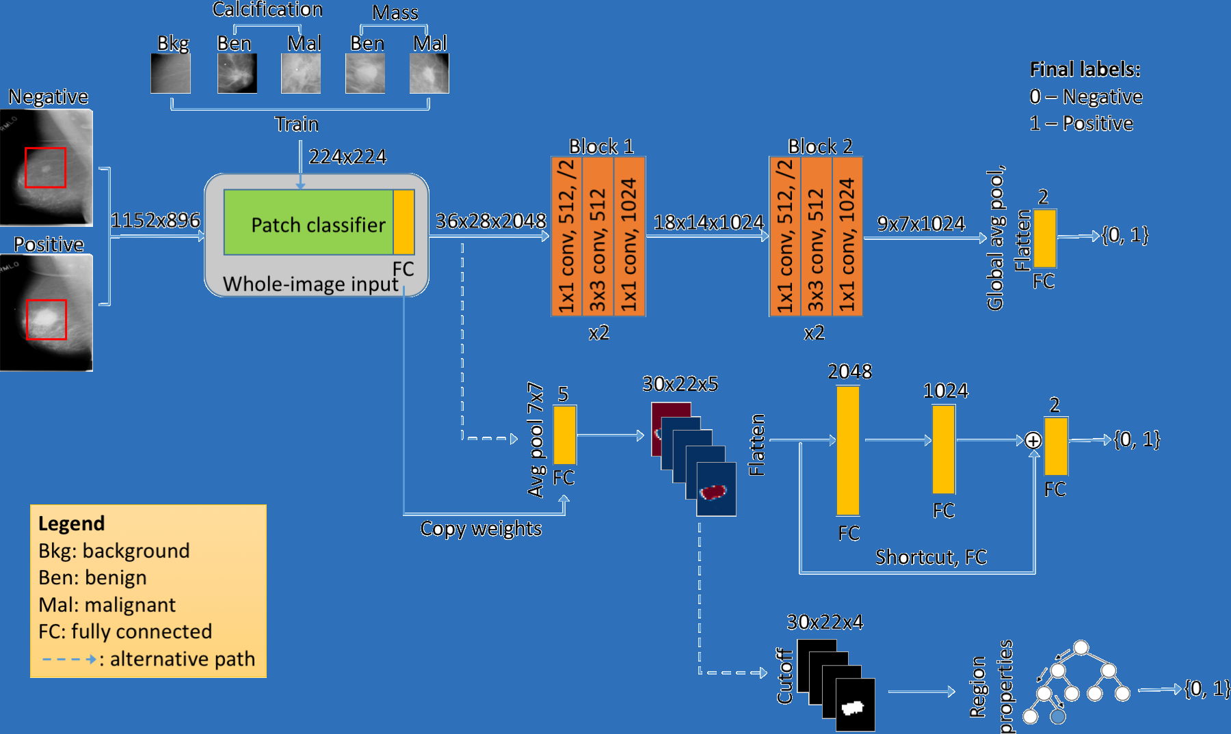
Idea / Approach details
Describe your Use Case here
Tools and Technology Used: Dependencies:
JUPYTER Notebook Details of patients
Python3 Details of test report

